Slide 1
Software Horrorshow How the Data Definition could Save your Life
Chris Campbell
Senior Consultant
ccampbell@mango-solutions.com
@CSJCampbell

Slide 2
Who are Mango?
Data Science
Tool/Framework Development
Consulting
Training R & Python

Slide 3
Software Development
Identify challenge
Specify behaviours of solution
Describe ways of working
Design tool
Build, test, deploy

Slide 5
Errors
Protect
Communicate

Slide 6
Errors
# provide informative message
stop(
paste(
"numeric input expected",
"but x was",
typeof(x)))

Slide 7
Data Definition
Defined Inputs
Handling Rules

Slide 8
Data Definition
Location | Type | Comments | Date | lon | lat

Slide 9
Data Definition
Location | Type | Comments | Date | lon | lat
Defined Inputs
Handling Rules

Slide 10
Data Definition
Location: Description of Site
Type: Sighting Category
Comments: Description of Sighting
Date: Date of Sighting
lon: Site position East or West of the Greenwich Meridian
lat: Site position North or South of the Equator

Slide 11
Types
Storage Mode
Raw
Logical
Integer
Double
Complex
Character
List
Class

Slide 12
Types
Location | Type | Comments | Date | lon | lat
Character | Factor | Character | Date | Numeric | Numeric

Slide 13
Missing Values
Remove
Impute
Raise Error

Slide 14
Missing Values
Location | Type | Comments | Date | lon | lat
Character | Factor | Character | Date | Numeric | Numeric
Ignore NA + | Ignore NA + | Set blank ++ | Ignore NA + | Remove NA * | Remove NA *
+ Ignore if missing
++ Set blank if missing
* Remove record if missing
$ Error if missing

Slide 15
Data Out of Range
Business Rules
Treat as Missing
Correct
Update Specification

Slide 16
Data Out of Range
Location | Type | Comments | Date | lon | lat
Character | Factor | Character | Date | Numeric | Numeric
Ignore NA + | Ignore NA + | Set blank ++ | Ignore NA + | Remove NA * | Remove NA *
0 ch | 1 level | 0 ch | 1700-01-01 | -180 | -90
128 ch | 1 level | 2048 ch | Today | 180 | 90
Truncate ££ | Set NA £ | Truncate ££ | Set NA £ | Remove # | Remove #
£ Missing if out of spec
££ Truncate if out of spec
# Remove record if out of spec
@ Error if out of spec

Slide 17
Encoding
Internationalization
ASCII
A-Za-z
0-9
!"$%&'()*+,-./:;<=>?@[\]^_`{|}~
Notes:
American Standard Code for Information Interchange

Slide 18
Encoding
Latin-1 Supplement Unicode

Slide 19
Encoding
# non-ASCII encoding
x <- "Cardross - Laura's Café"
iconv(x,
from = "latin1",
to = "ASCII",
sub = "byte")
# [1] "Cardross - Laura's Caf<e9>"

Slide 20
Encoding
Location | Type | Comments | Date | lon | lat
Character | Factor | Character | Date | Numeric | Numeric
Ignore NA + | Ignore NA + | Set blank ++ | Ignore NA + | Remove NA * | Remove NA *
0 ch | 1 level | 0 ch | 1700-01-01 | -180 | -90
128 ch | 1 level | 2048 ch | 2018-10-31 | 180 | 90
Truncate ££ | Set NA £ | Truncate ££ | Set NA £ | Remove # | Remove #
ASCII | ASCII | ASCII

Slide 21
Dates & Timestamps
Diverse
Ambiguous
Timezones

Slide 22
Dates & Timestamps
# Date class
as.Date("2018-11-29")
[1] "2018-11-29"
# Days since 1970-01-01
as.Date(17864, origin = "1970-01-01")
[1] "2018-11-29"

Slide 23
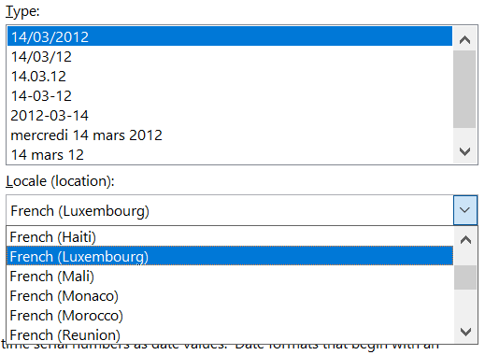

Slide 24
Dates & Timestamps
Location | Type | Comments | Date | lon | lat
Character | Factor | Character | Date | Numeric | Numeric
Ignore NA + | Ignore NA + | Set blank ++ | Ignore NA + | Remove NA * | Remove NA *
0 ch | 1 level | 0 ch | 1700-01-01 | -180 | -90
128 ch | 1 level | 2048 ch | 2018-10-31 | 180 | 90
Truncate ££ | Set NA £ | Truncate ££ | Set NA £ | Remove # | Remove #
ASCII | ASCII | ASCII | (%d) (%b) %Y %d %b $$
$$ Record reoccurring sightings in 2016

Slide 25
Data Volume
Time to respond
Interpretability

Slide 26
Data Volume
Location | Type | Comments | Date | lon | lat
Character | Factor | Character | Date | Numeric | Numeric
Ignore NA + | Ignore NA + | Set blank ++ | Ignore NA + | Remove NA * | Remove NA *
0 ch | 1 level | 0 ch | 1700-01-01 | -180 | -90
128 ch | 1 level | 2048 ch | 2018-10-31 | 180 | 90
Truncate ££ | Set NA £ | Truncate ££ | Set NA £ | Remove # | Remove #
ASCII | ASCII | ASCII | (%d) (%b) %Y %d %b
Segment records so that no more than 200 are displayed simultaneously

Slide 27
Save your Life
Define all inputs
Define what happens when data is out of spec
Implement

Slide 28
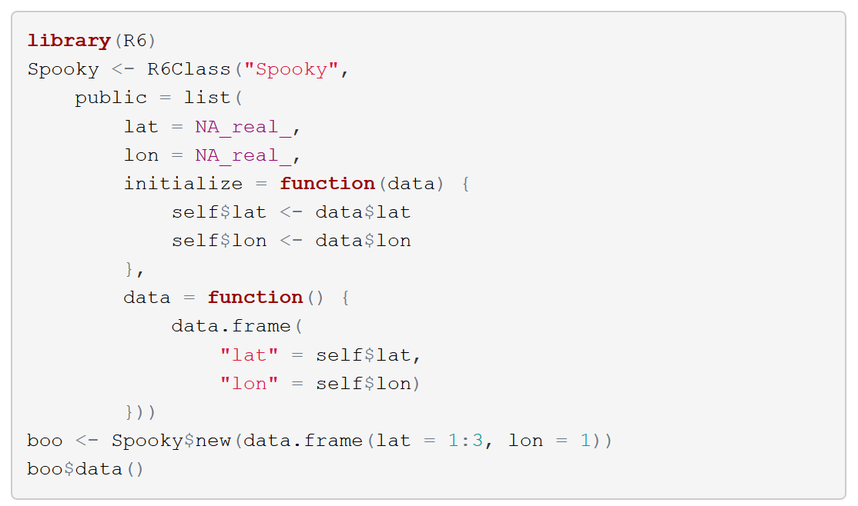
R6 Classes

Slide 29
How to Play
R & RStudio
Download https://github.com/CSJCampbell/CurseUnspecDataDef
Install
leaflet
dplyr

